Slide 1
Differentiation
By Carlo, Jessica, and Olivia
Notes:
-Felt right to do this topic, social dynamic of classrooms today
-Unlikely that you will have to walk into classroom without having to differentiate
-Not necessarily that classrooms are getting worse, we are just becoming more aware of peoples learning needs
-Olivia with math experience: struggled with math, but not enough resources to give her what she needed
-After triad meetings, we all realized that differentiation has been a common theme amongst all of our practicums

Slide 2
Equity vs. equality
Notes:
-We recognized the value of appreciation each student’s unique learning needs
-We have seen this picture come up many times during our schooling, but really recognized the significance of it’s real-world application in the classroom
-Just because every student is given the same thing, doesn’t mean we are providing the students with what they need as individuals
-Jess: flexible seating. Had to explain to the kids that some people need it, and some people don’t. Had to explain why some students NEEDED (vs. wanted) the rocking chair at the carpet.
-Carlo: if your tool is becoming a toy, it is no longer a tool. (i.e. fidget becoming a toy). Had to explain the importance of using fidgets for learning needs.
-Olivia: didn’t have to explain to students. They understood that people getting different things was equity. Olivia provided scribing for some students, and other students understood why they were not offered option (because they did not need it). Equity vs. equality becoming more of a theme within schools.

Slide 3
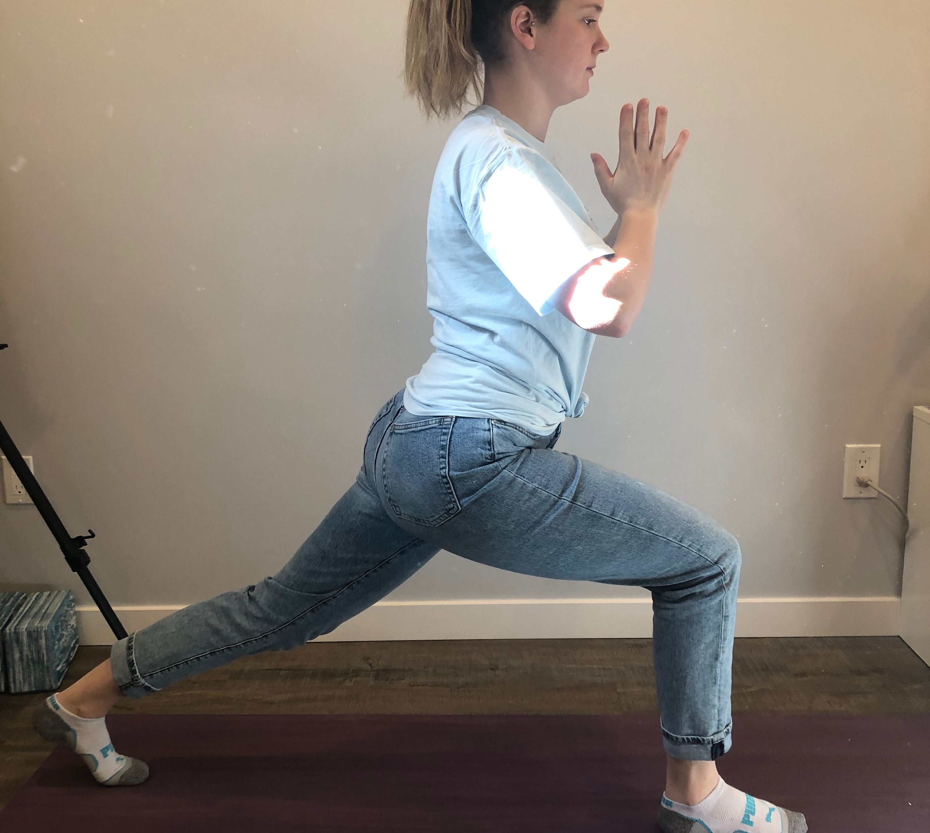
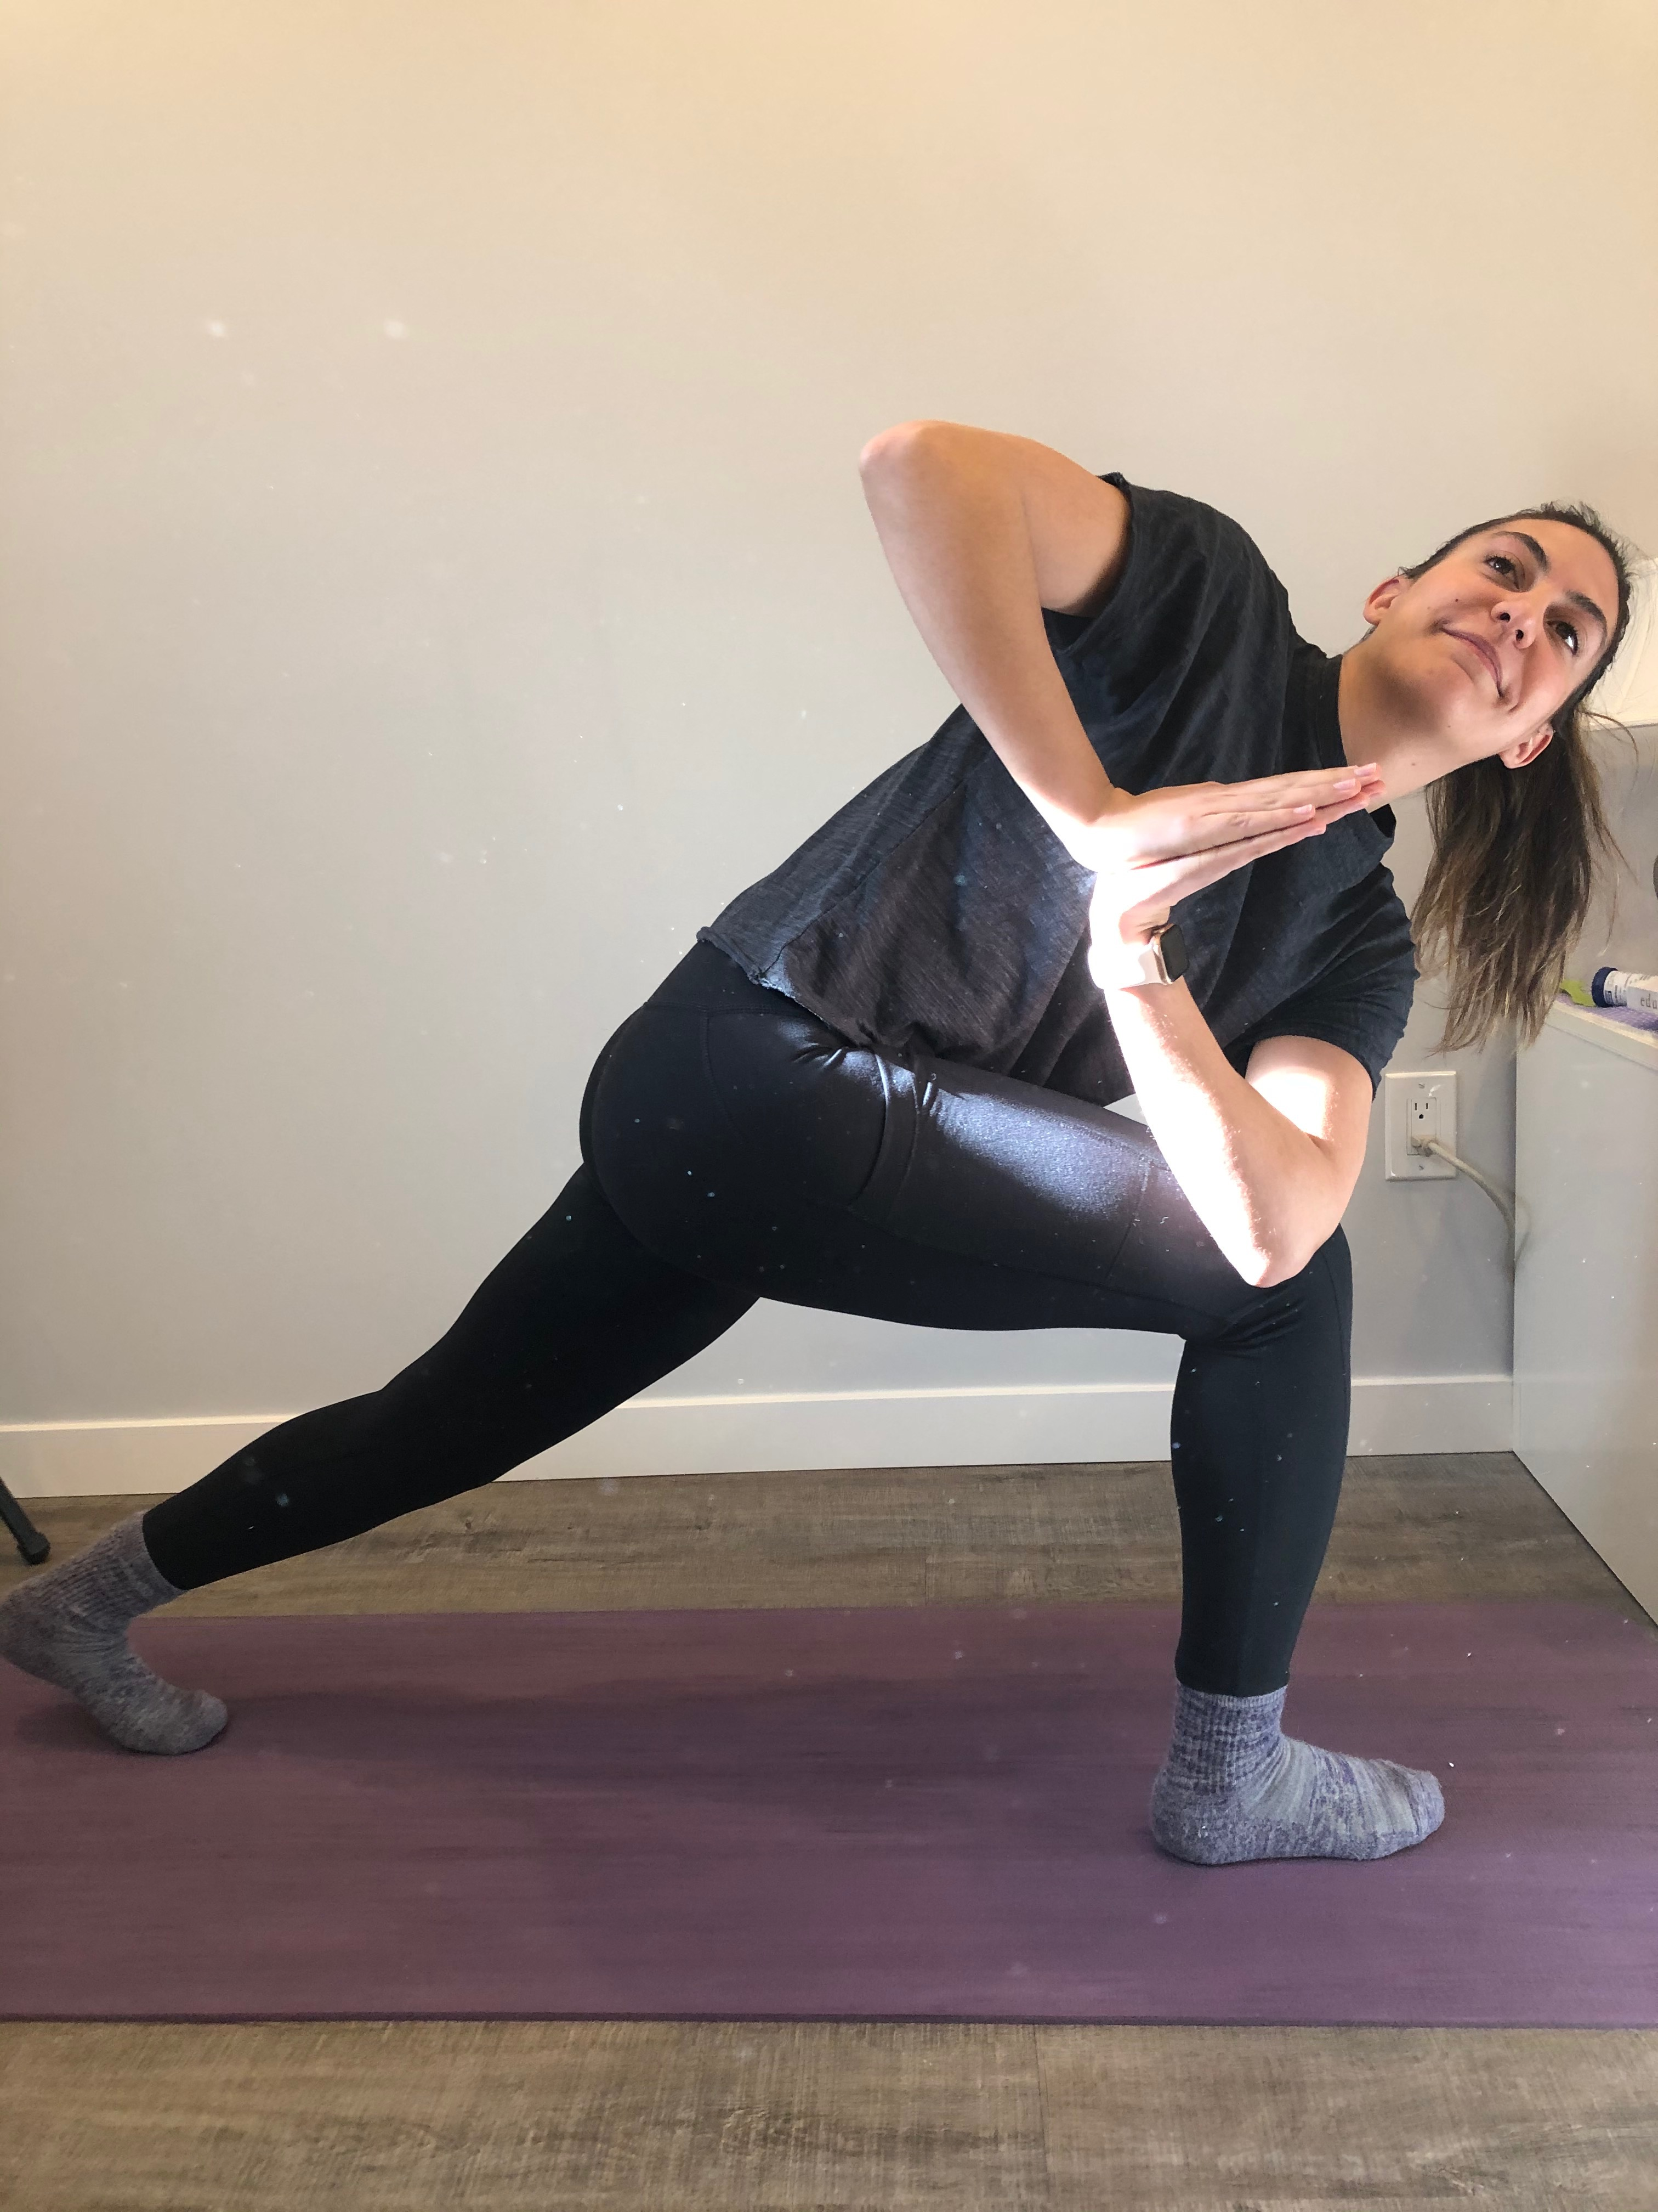
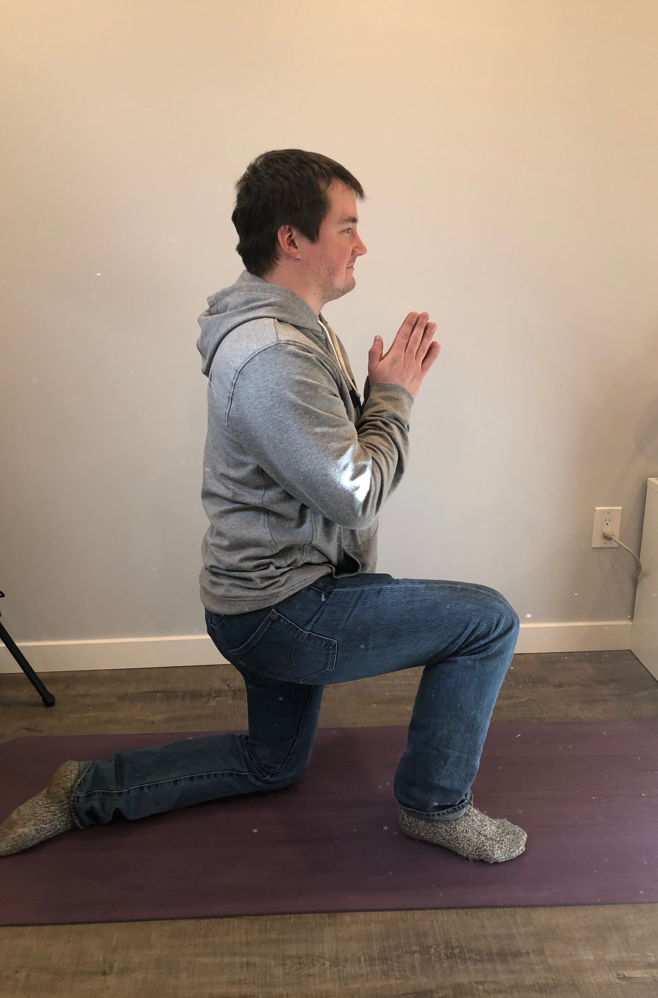
Access points
Notes:
-We all recognized the importance of providing an access point to everybody
-Single point rubric VS. Tradition rubric
-Triad had discussion about single point rubric VS. traditional rubric: how traditional rubrics should not be given to kids (Sandra Herbst) because they are overcrowded and limiting. Students will try to meet the minimum and call it a day. With single point rubrics, students are aiming for a goal and either meet it or don’t. It is much easier for them to track. This encourages the growth mindset theory because it doesn’t encourage kids to only meet their minimum, but rather encourages students to think about how they are working past it.
--Jess: At first was worried about students abusing the access point, but soon found that the novelty of using the access point wore off. Students challenged themselves appropriately and only using the access points when needed.
-Carlo: Connecting with each students and pushing them to try and extend.
-Olivia: Formative assessment really important for gauging level of learning/need for access point.
Photo description: In our yoga analogy (inspired by Katie Marren) Carlo is doing our access point pose. Olivia has taken it to the next step by lifting her back knee. Finally, Jessica is in the final form of the pose with back knee lifted and torso twisted. Each yogi has an opportunity to complete this pose at a different level. Just as access points apply in yoga, they apply in education. We should be providing every learner with an access point to start with, and give students the opportunity to challenge themselves as they go.

Slide 4
Math
Notes:
Carlo: Trying to use many different methods of teaching (whiteboards, manipulatives, puzzles, etc.). Giving the students the opportunity to decide which strategy and tools work best for them. Presesnting different styles of summative assessment (Van De Walle Big 5- Carol Fullerton, page of multiplication questions, etc.)
Olivia: Math groups to accommodate different levels of learners. Classroom evolved to this, because originally was doing all as one lesson. At the access point was able to do all as one class, but once moved into dividing decimals this was not feasible. Math groups ended up working really well because she was able to teach to small groups and give students smaller instruction. Obstacle: when teaching kids that were extending, the kids that weren’t extending were getting very confused. The extra instruction confused them. Math lessons were really heavy on the use of manipulatives.
Jess: Did a mix of large group instruction and small groups. First would do large group lesson with whole class (based on grade) and then would take small groups of both high and low learners to teach more. After math task was completed, made groups of mixed-ability learners for math games.

Slide 5
Language arts
Notes:
Jess: Did leveled literacy intervention (Fontas & Pennell) for struggling readers. Some students were at a grade 5 reading level, so did book boxes and a novel student with these students. HUGE different in reading levels but was able to accommodate each and every one.
Olivia: 6 novel study groups for literature circles. For the most part, was pretty on with the differentiation. Lowest group ended up surprising her, had a conversation with them and picked out a book together. This was mid-way through the project. To see a group as low as them take such ownership and joy in picking out a new book let her know that these students were still engaged in the project and wanted wanted to take part in creating new criteria.
Carlo: Collaborating with professionals around the school to provide students with access to other programs. Some students had to leave his class in order to attend LLI sessions.

Slide 6
Challenges/Barriers
Notes:
Olivia:
-Math: how deep to go and how simple to break it down to access students learning at Gr. 2 level, but extending enough for students at Gr. 10 level.
-Chunking information so that students could still get the SS/Science concepts without the obstacle of higher-level language arts processes of learning
-Having 9 students that needed an EA, of those 7 needed one-on-one support but did not receive due to lack of resources.
Jess:
-Not having an EA to students in the process of getting designated
-Ensuring different groups were on task while working with small groups
Carlo:
-Not having access to an EA in the class.
One of the main challenges all three of us saw involved both educators and learners. A lot of times, learners and educators do not know where they are at in terms of differentiation because they are not taking the time to explore. We have found that using the First Peoples Principles of Learning, “Learning requires the exploration of one’s identity” and embedding it within learning has aided us in encouraging ourselves and our learners to find where we are at.

